Slide 1
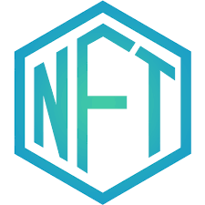
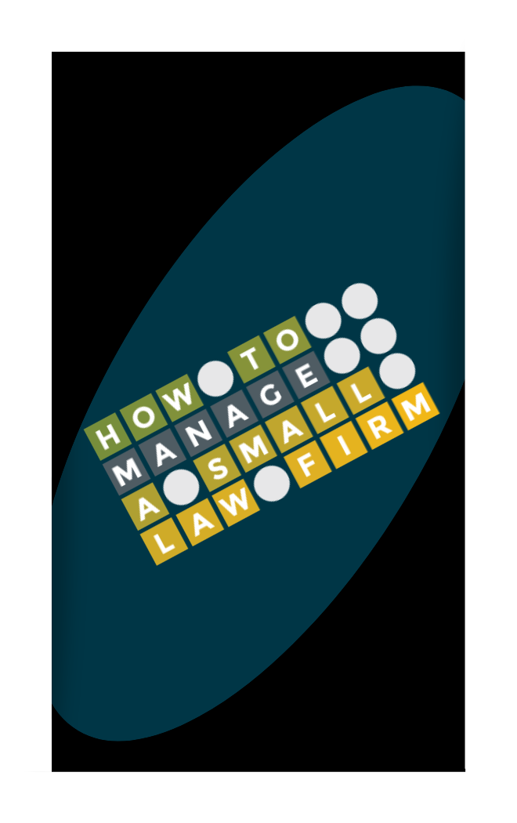
TO THE FUTURE
OF BUSINESS
WELCOME
WELCOME

Slide 2
THE OPPORTUNITY
WHY NFT?

Slide 3
THE WHY
What does a utility NFT mean for HTM?
An NFT assigns a use to the multilevel tiered digital asset outside of owning a piece of artwork. In our project the utility NFT can be where someone receives unique access to:
an event,
exclusive in-person memberships,
workshops,
limited experiences,
subscription membership,
access to gated content,
NFT access passes to exclusive offerings for top tier members,
NFT branded marketplace billed as a monthly subscription using the $HTM token, or
to let users mint membership NFT/tokens using credit cards.

Slide 4
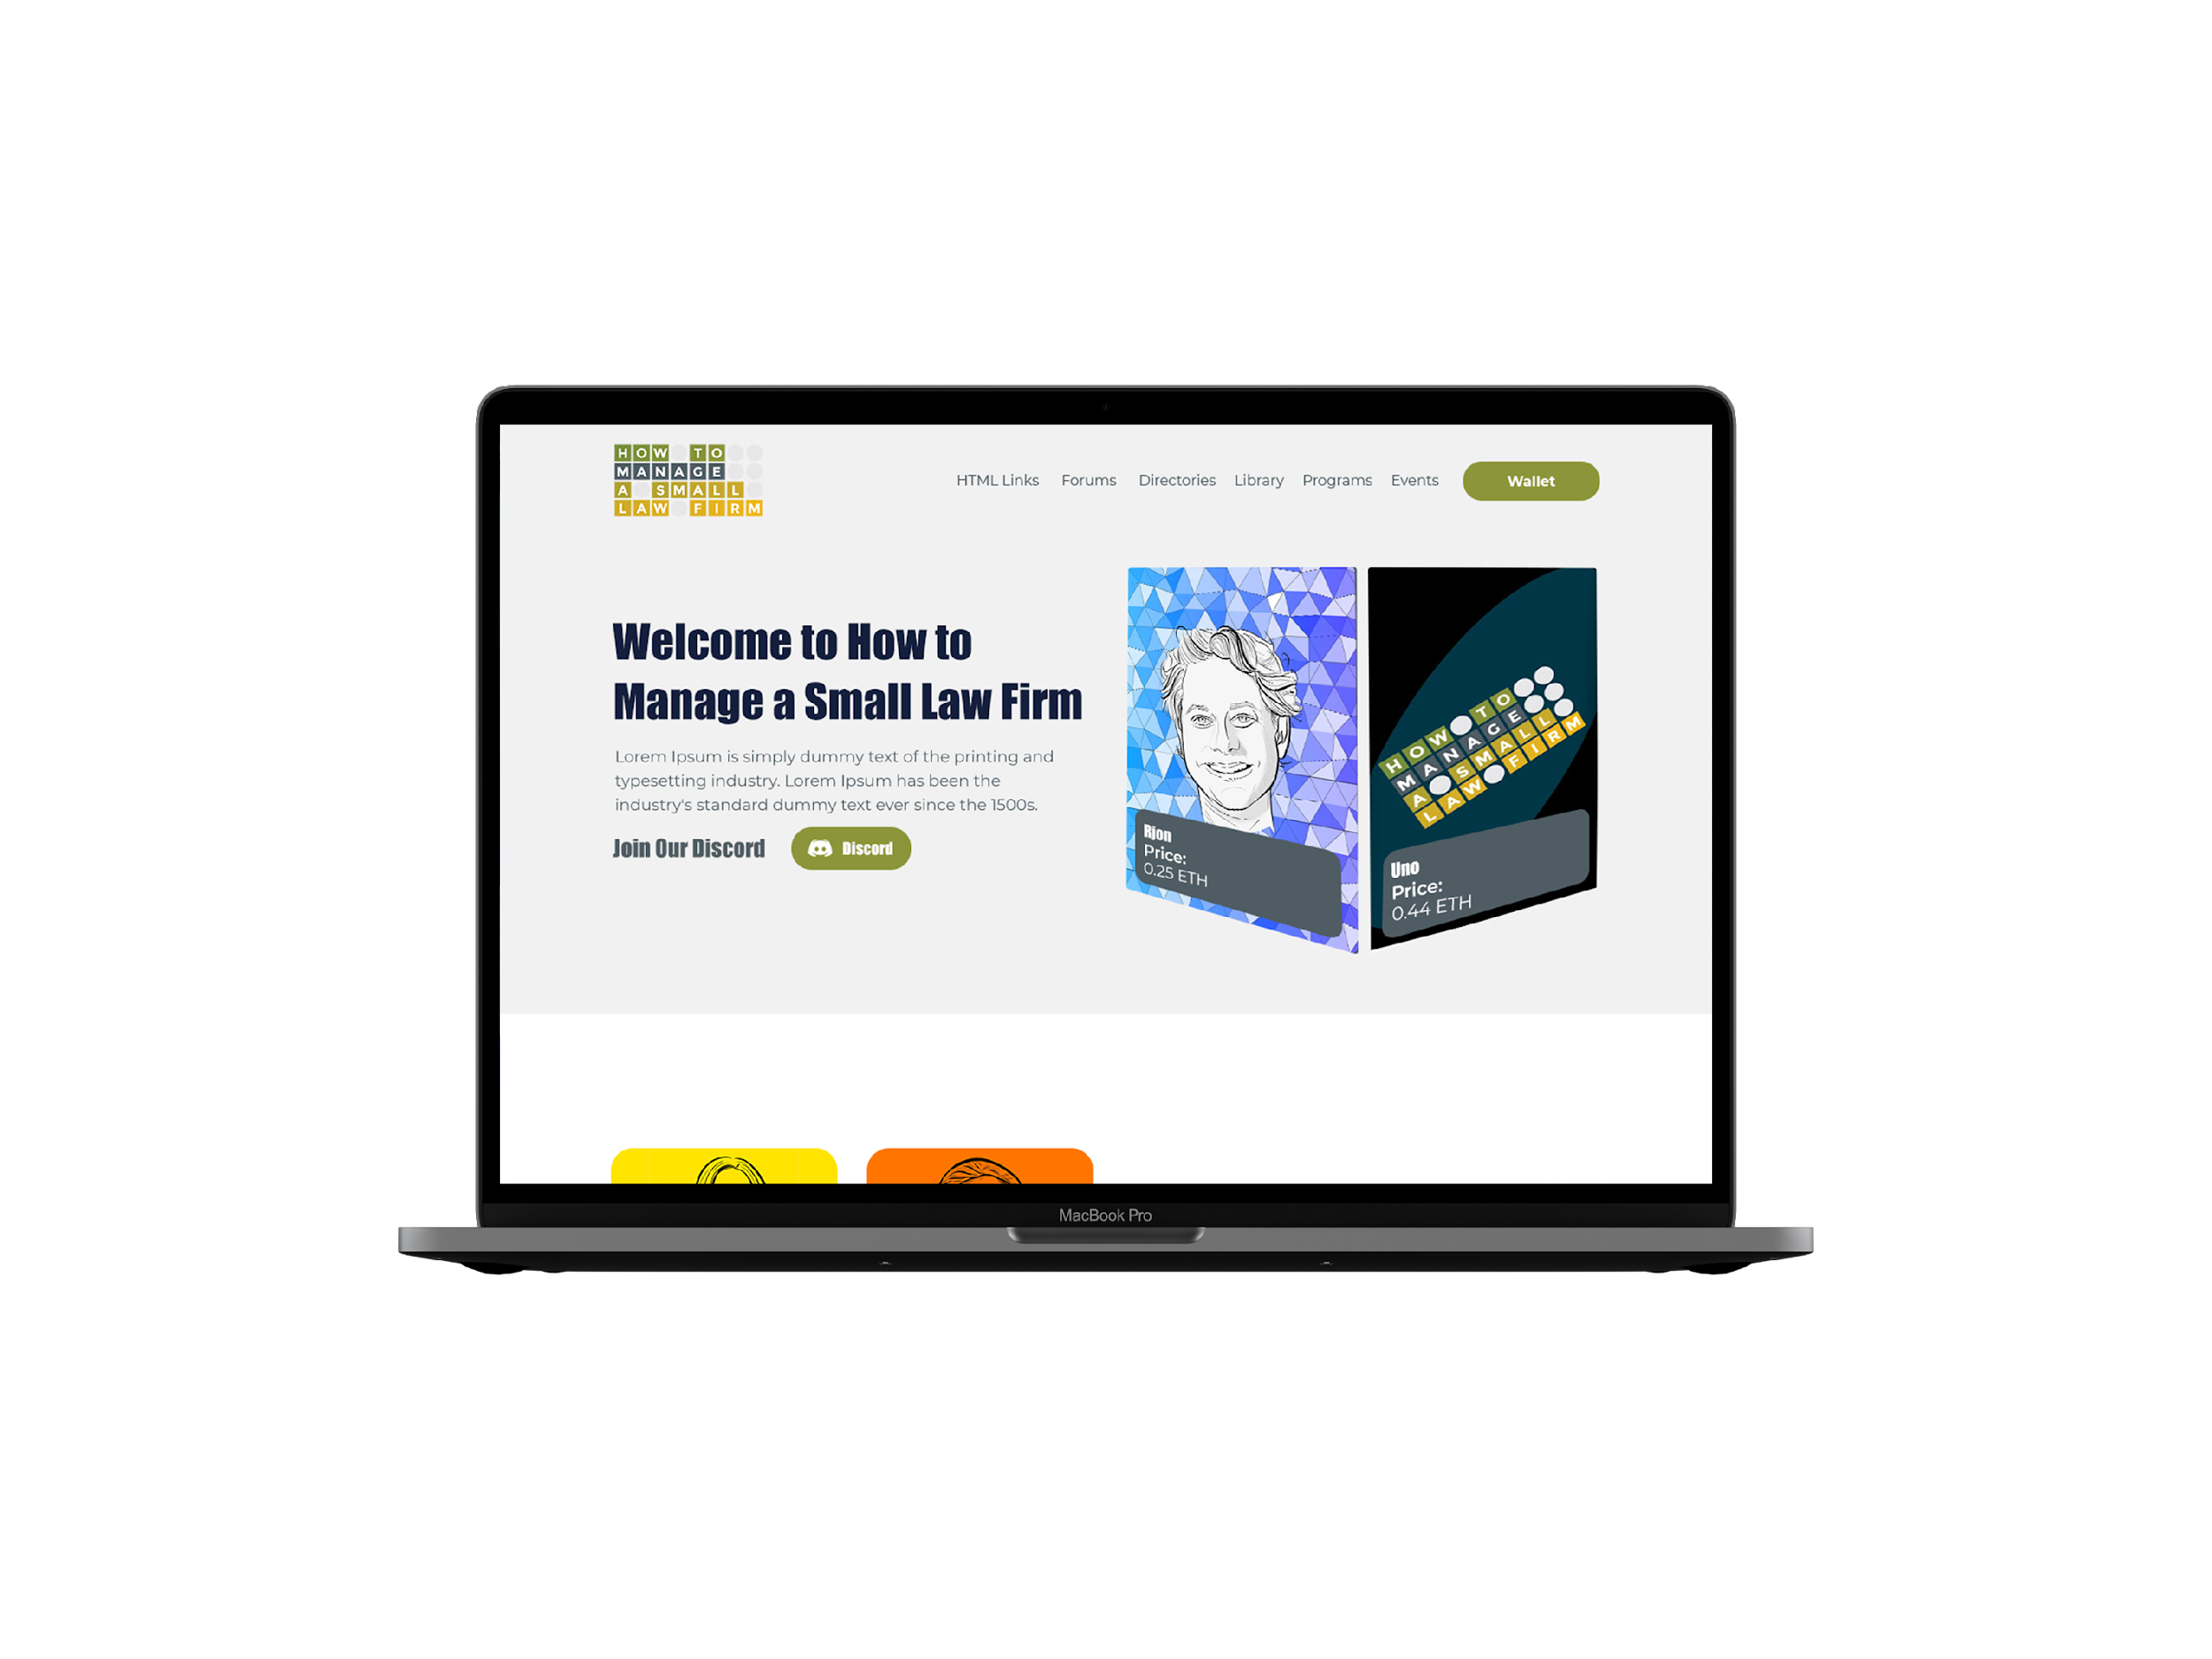
NFT MEMBERSHIPS
NFT holders can gain access to clubs via membership. By holding membership, NFTs can continuously unlock new value over the lifetime of membership for holders. NFT memberships are unlike traditional memberships that are traditionally non transferable. With NFT's, the membership can increase in value, allowing members to sell their NFT memberships for a profit.
Second, the secondary market can create an entirely new revenue stream for the membership creators.
An example of a successful NFT membership is VeeFriends. This membership entitles the members to Conference tickets, NFT drops, meetups, and more. This is just one example of what is possible with NFT memberships which verify your membership by checking your ownership of the NFT against the blockchain.

Slide 5
NFTs as Tickets
Have you ever purchased a ticket for a concert, sports, or other major events through a secondary sale like a scalper? How do you know the tickets you are buying are indeed legitimate tickets from such a second party? You don't because you have no way to verify the ticket's origin or its authenticity.
Enter NFT tickets. Fans can now buy tickets to a major event, verify the authenticity and prove ownership as the physical ticket links to a digital NFT on the blockchain. Scan the QR code, and bam, and you can instantly verify the ticket's ownership.
How does this help HTM? HTM already sells tickets to workshops, but HTM has no secondary market. What happens when someone runs to the back of the room overzealously and now doesn’t want the ticket to the sold-out workshop? HTM tears up the contract. Well, how about this…

Slide 6
NFTs as Tickets (Cont.)
If the member doesn’t want the ticket and wants to sell this ticket to someone on the secondary market, HTM can still earn a commission on the secondary sale. Ticket prices can even increase past the original purchase price, and the commissions automatically adjust according to the sale price. The secondary market can be an entirely new revenue stream for HTM, which is impossible with paper the current system.
In traditional sales, you lose the touchpoint to the members that attended the event over time once the event is over. With NFT's events can continue dropping benefits to all the prior attendees because they own the NFT. It can be in invites to future events, access to coaches or management, and much more. This ability adds considerably more value to tickets than what we have today.

Slide 7
Offering NFTs for Fractional Investment/Ownership
Imagine any physical product delivered with an NFT. The NFT, just like in the ticket example, can verify ownership and authenticity. The NFT is the ownership contract for the product backed up to the blockchain. The blockchain also enables an entire product sales audit history.
One example is a cask of Whiskey which verifies ownership. The Metacask sold a Cask of Whiskey as an NFT for 2.3 million dollars.
How will this work for HTM? Each time Rjon has a great idea that Oscar says no to, Rjon could offer it to the members and the members could get to be participants and not just the audience. The event/product could be offered as one NFT with fractional ownership to crowdsource and pool the risk or to invest in a project that be profitable down the line. (Like VeeFriends Viper NFT)

Slide 8
2. The HOW

Slide 9
HOW: SMART CONTRACT
Smart contracts easily fulfill workflow around any start & end date periods — they are contracts after all.
Benefits:
they can be programmed to auto-renew people,
they can be programmed to incentivize referrals,
they can be programmed to incentivize people to renew, and
they can be programmed to automatically provide additional services to the owner of the NFT at a later point in time, forever.

Slide 10
HOW: SMART CONTRACT (Cont.)
Embedded metadata allows for different levels or properties to be explicitly called out. This is a key in membership organizations. Think of a 1/1 or a 1/10 or a 1/200 that is created. Each may have different value based on scarcity or rarity; however, the value can also be put into real practice by providing a unique and engaging experience for those 1/1 folks. Perhaps at the highest membership level perks are given out. Whereby at the 1/200 level some things cost a little extra from time to time or they miss out on some perks. To keep it really interesting, we create a lot fewer of the 1/1 pieces, perhaps it’s a different color background or a completely different image and increase the price for them just as you would any other membership tier.

Slide 11
HOW: SMART CONTRACT (Cont.)
As NFTs store additional metadata, things such as achievements through a membership ladder are easily fulfilled by “minting and air dropping” new achievements to already existing members. Now we have a way to see where people are within the organization membership structure. Perhaps at each level of firm growth ($1m, $2m, $3m), or a participation in levels of Mastermind or Mindset workshops, etc., get a specially airdropped NFT that give status differentiation among the community members.

Slide 12
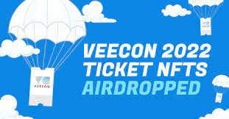
THE VEECON EXPERIENCE

Slide 13

THE NFTs
Description: The Diamond Rjon token allows you a premium seat at any of Rjon’s LQMs occuring during the time period from 2023 to 2024 with additional green room access to meet Rjon at all such events.
Edition: 1/1
Creator: HTM
Contract Address: 0xa3ae...beeb
Token ID: 6650
Token Standard: ERC-721
Blockchain: Ethereum
Creator Fees: 10%

Slide 14
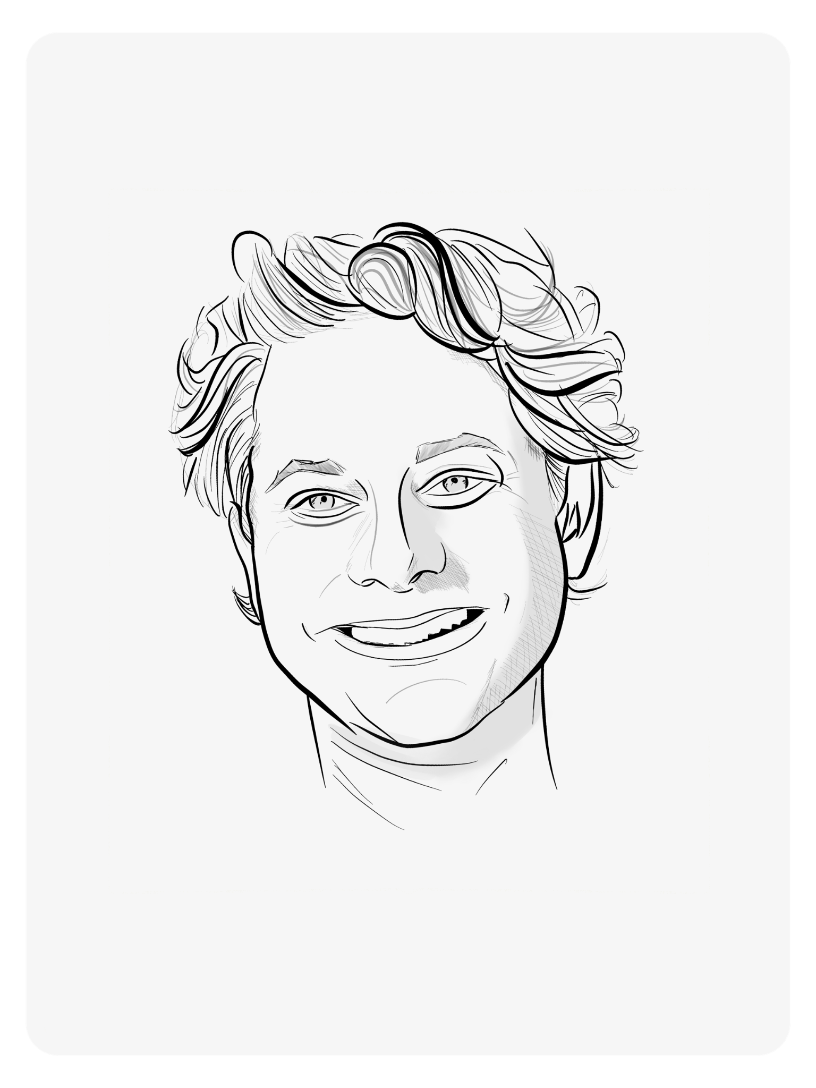
THE NFTs
Description: Rjon Radio
Each holder of a Rjon Radio token will have Rjon Robins appear as a guest on their podcast for forty (40) minutes per "year" (i.e.) Each year shall be defined as the twelve month time period commencing on January 1, 2023 and December 31, 2023. In no event shall any experience (including this experience) occur after XXX (date).
Edition: 5/5
Creator: HTM
Contract Address: 0xa3ae...beeb
Token ID: 6651
Token Standard: ERC-721
Blockchain: Ethereum
Creator Fees: 10%

Slide 15
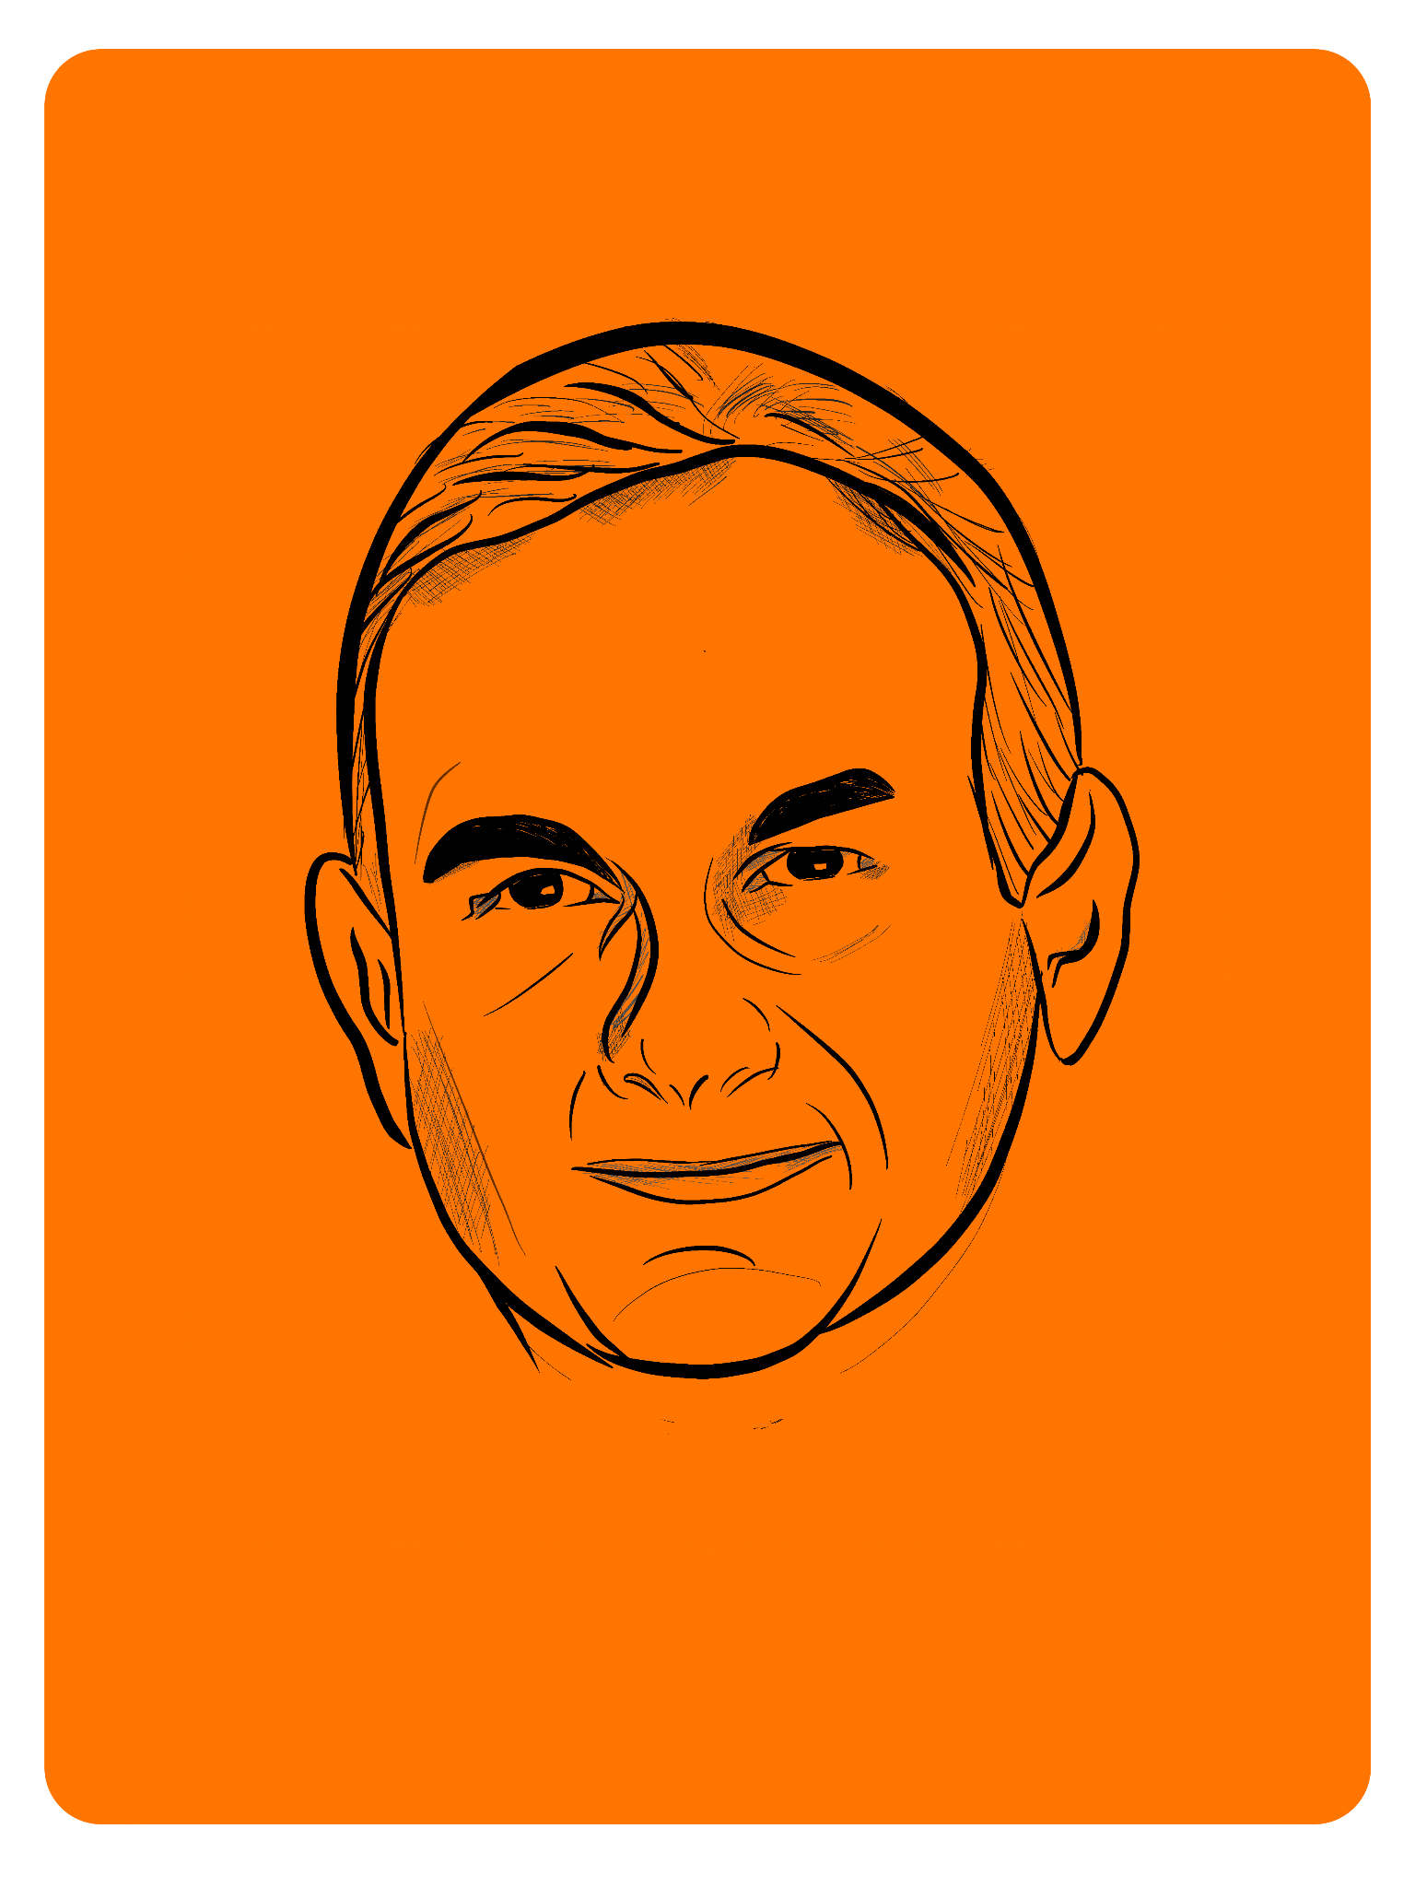
THE NFTs
Description: Supper with Oscar
The holder of the Supper with Oscar token will share one (1) ninety (90) minute one-on-one (1 on 1) dinner with Oscar. In no event shall any experience (including this experience) occur after XXX (date).
This token is verifiable for admission to one (1) Overnight Success Club event, TBD.
Edition: 10/10
Creator: HTM
Contract Address: 0xa3ae...beeb
Token ID: 6652
Token Standard: ERC-721
Blockchain: Ethereum
Creator Fees: 10%

Slide 16

THE NFTs
Description: Erika’s Leadership Lifeline
Each holder of a Erika’s Leadership Lifeline token will be granted four (4), thirty (30) minute video calls with XXX, max one (1) per ''Quarter'' (i.e.). Each quarter shall be defined as the standard recognized business three-month time period commencing in Q1-January 1, 2022 thru March 30, 2022, Q2-April 1, 2022 thru June 30, etc. In no event shall any experience (including this experience) occur after XXX date.
This token is verifiable for admission to one (1) Overnight Success Club event, TBD.
Edition: 10/10
Creator: HTM
Contract Address: 0xa3ae...beeb
Token ID: 6653
Token Standard: ERC-721
Blockchain: Ethereum
Creator Fees: 10%

Slide 17
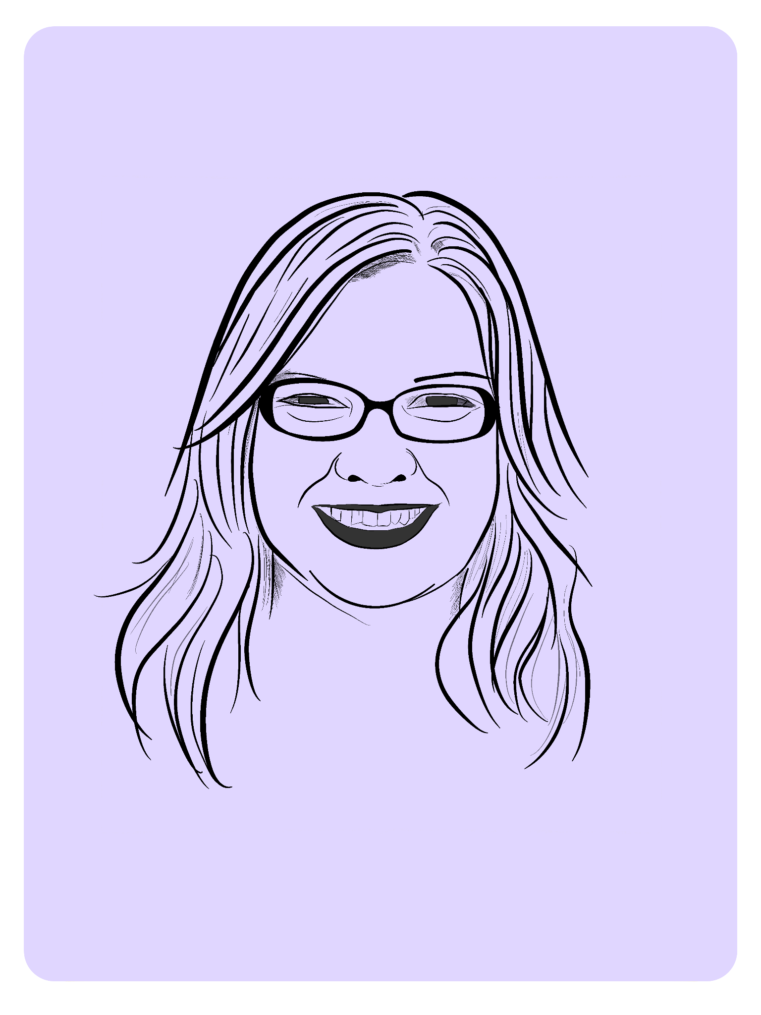
THE NFTs
Description: Renee’s Row
The Renee’s Row token allows you a premium front row seat at all four (4) How To Manage LQM events occurring during the calendar year 2022 with additional green room access to speak with Rjon and/or Erika at all such events for a semi-private group Q&A not to exceed twenty (20) minutes.
This token is verifiable for admission to one (1) Overnight Success Club event, TBD.
Edition: 10/10
Creator: HTM
Contract Address: 0xa3ae...beeb
Token ID: 6654
Token Standard: ERC-721
Blockchain: Ethereum
Creator Fees: 10%

Slide 18

THE NFTs
Description: General token
Admission to all LQM events each quarter provided subscription is paid in full in advance. Access will be revoked upon nonpayment of dues.
Edition: 400/400
Creator: HTM
Contract Address: 0xa3ae...beeb
Token ID: 6655
Token Standard: ERC-721
Blockchain: Ethereum
Creator Fees: 10%

Slide 19
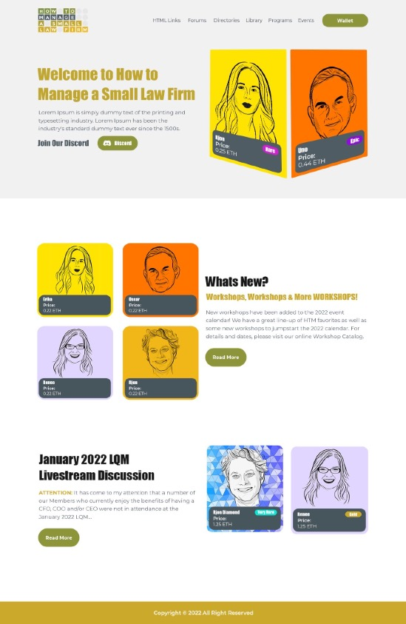
WEB3 SITE

Slide 20
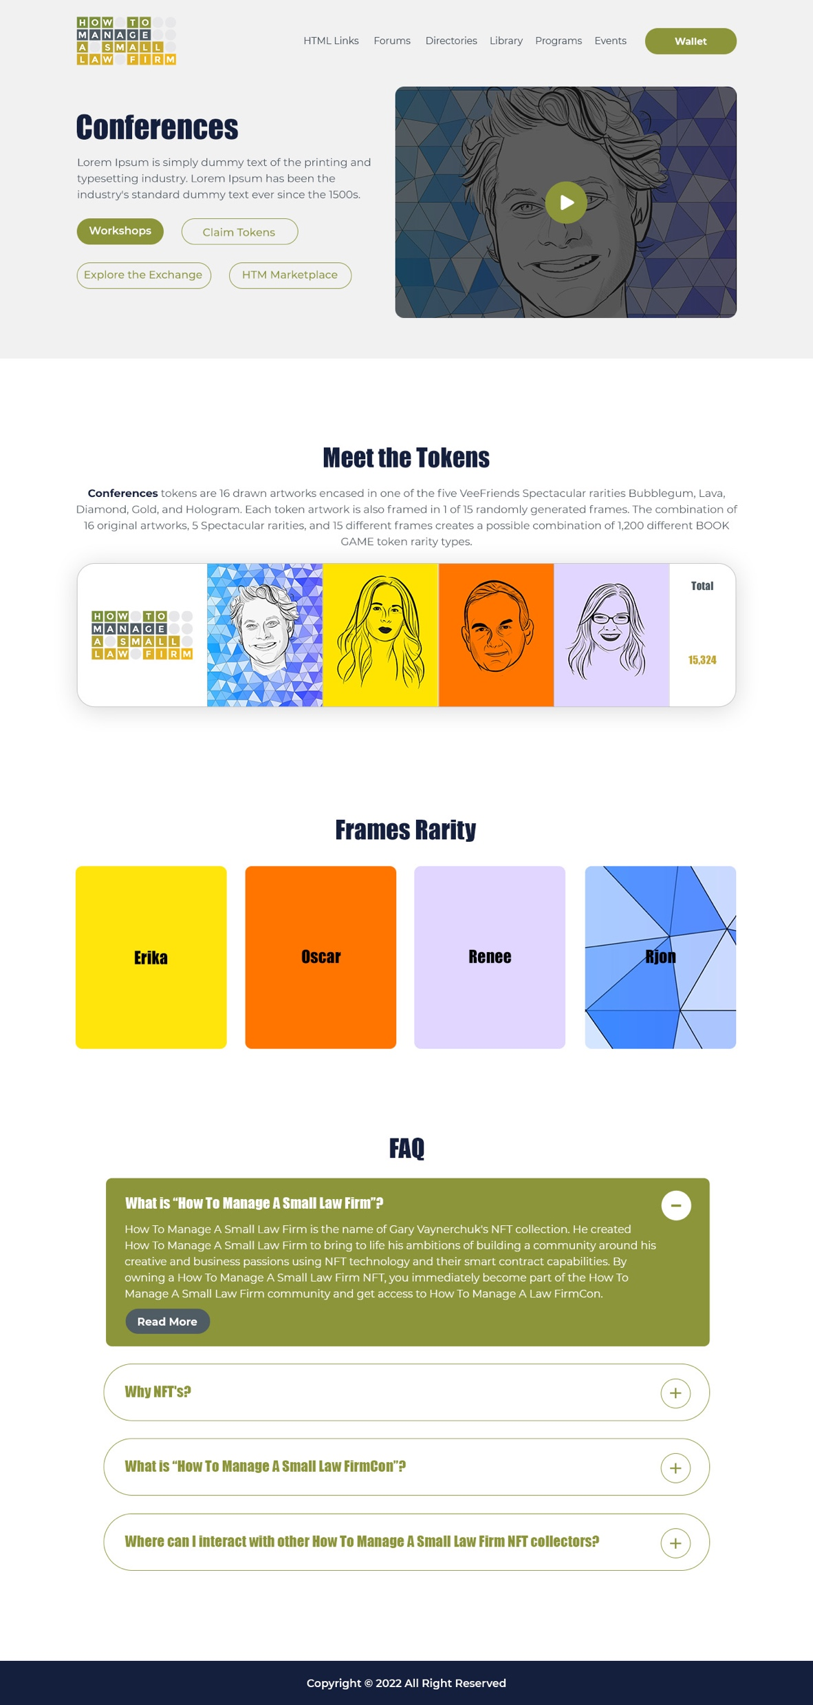
Planning process
Onboarding
Closing process
Ending project
Executing process
THE NFT

Slide 21
3.Education

Slide 22
Education
Crash Course
Metamask Wallet
Purchase Etherium
How to Mint
Discord Channel

Slide 23
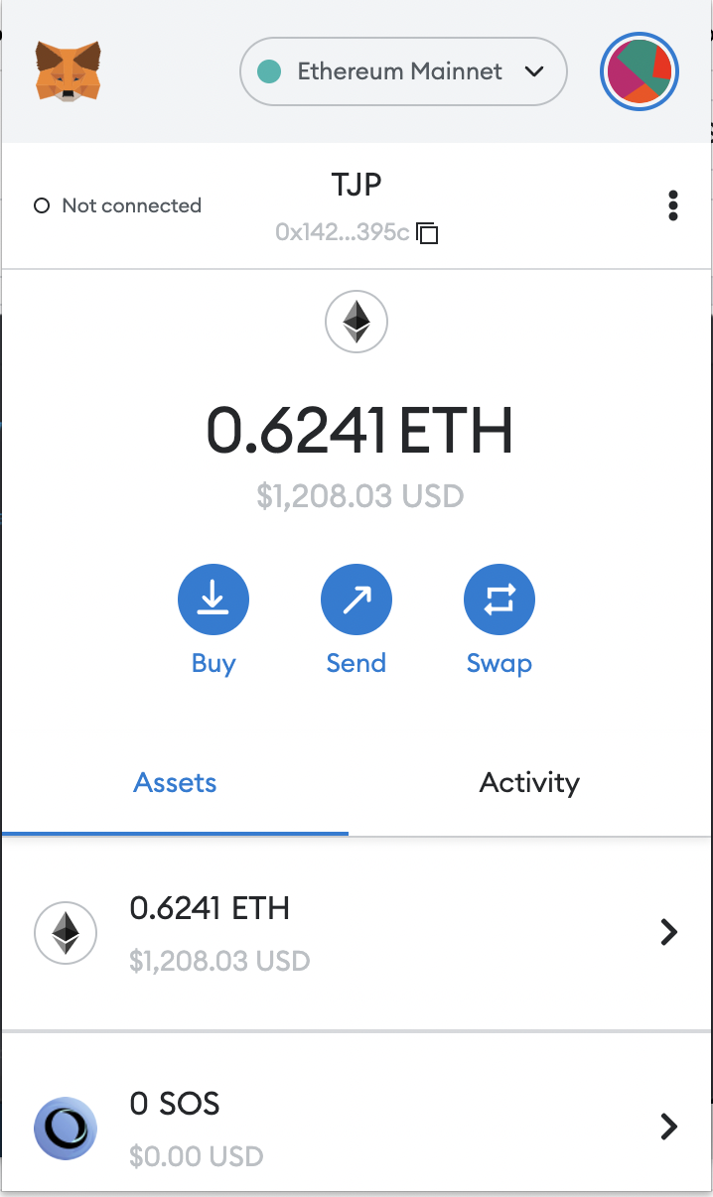
Education
Crash Course
Metamask Wallet
Purchase Etherium
How to Mint
Discord Channel

Slide 24
Education
Crash Course
Metamask Wallet
Purchase Etherium
How to Mint
Discord Channel
Private community
gated channels
level up mentality
decentralized platform
true creation ownership

Slide 25
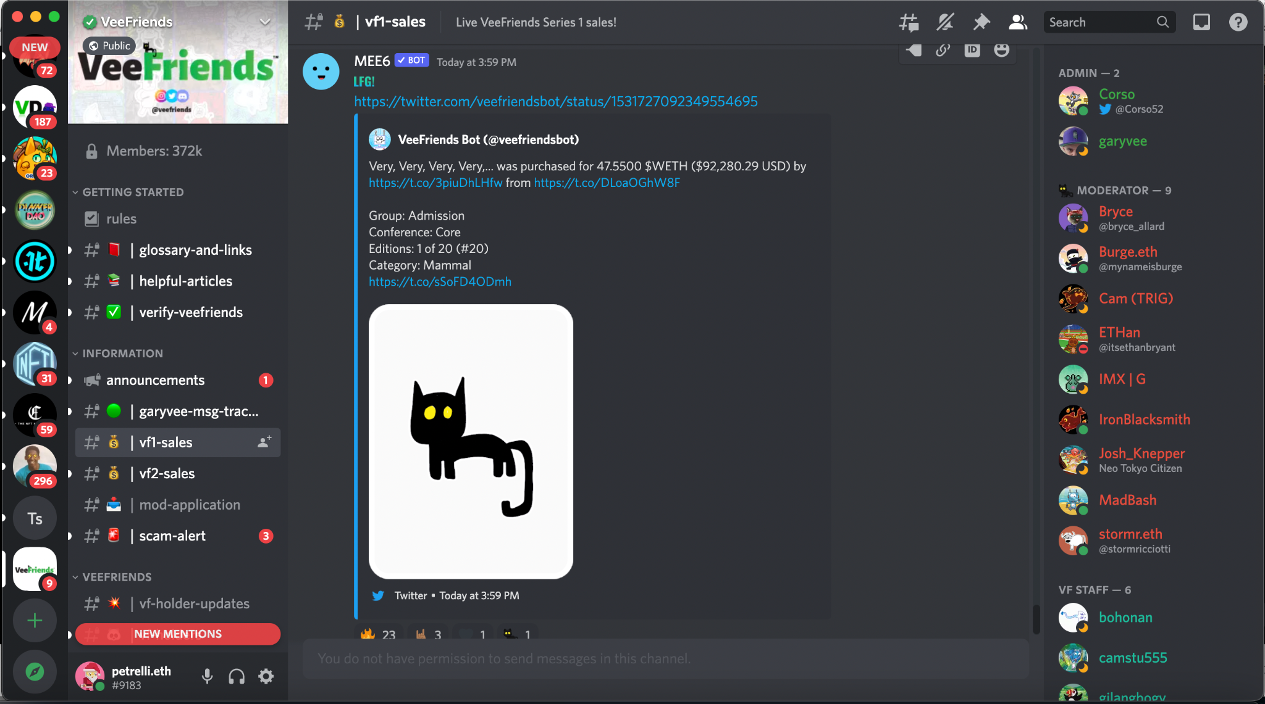
Education
Crash Course
Metamask Wallet
Purchase Etherium
How to Mint
Discord Channel

Slide 26
3.Benefits

Slide 27
Benefits
Cutting edge of technology
Ability to raise capital on demand b/c of tokenization
Future proof business
Decentralized community
Specific content
Stickiness: Retention and Buyin w/ Tokens
Value model vs Sales Model
LQM shift to value rather than sales especially for the higher grossing firms.
Bring speakers or whomever in to create cross selling synergy.

